Slide 1

Web scraping to gain company insights
19/10/2023

Slide 2
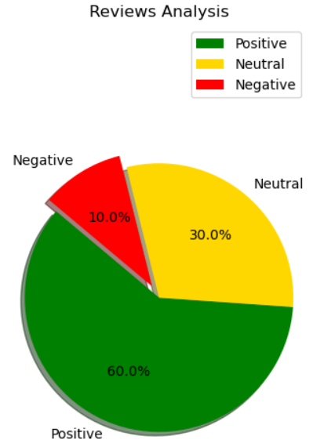
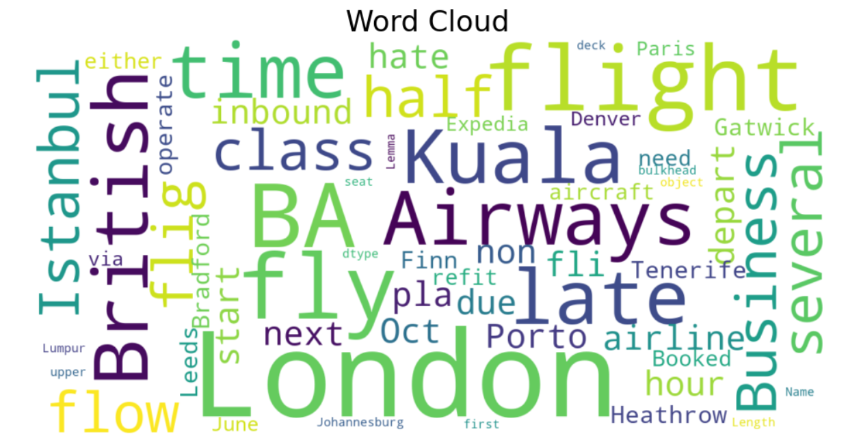
INSIGHTS FROM CUSTOMER REVIEWS
Analysing 1000 reviews by customers, I obtained
Positive Reviews - 482
Negative Reviews - 416
Neutral Reviews – 102

